Slide 1
Azure Machine Learning Algorithms
Viktor Tsykunov
Developer Experience and Evangelism Lead
Microsoft Ukraine
Viktor.Tsykunov@microsoft.com

Slide 2
Outline
Machine learning basics and definitions
Tour of machine learning algorithms
Examples and demos

Slide 3
What makes for a good ML problem?
Labeled* examples
Customer churn: records of current customers (loyal) + former customers who left (churn)
Fraud detection: examples of fraud and not fraud
Relevant features
Customer information: age, sex, zip code, historic spending patterns, etc.
Transaction information: amount, previous transactions, customer information, etc.
Uncertainty/error tolerance
Identifying some customers who are leaving is better than current system
Automated fraud identification still verified by human user

Slide 4
Why are labels important?
Most commonly used machine learning algorithms are supervised (requires labels)
Supervised learning examples
This customer will like House of Cards
This network traffic indicates a denial of service attack
Unsupervised learning examples
These customers are similar
This network traffic is unusual

Slide 5
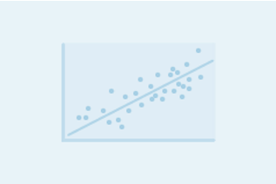
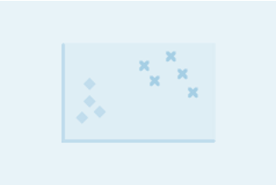
Regression versus Classification
Does your customer want to predict/estimate a number (regression) or apply a label/categorize (classification)?
Regression problems
Estimate household power consumption
Estimate customer’s income
Classification problems
Power station will/will not meet demand
Customer will respond to advertising

Slide 6
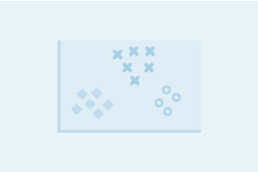
Binary versus Multiclass Classification
Does your customer want a yes/no answer?
Binary examples
click prediction
yes/no
over/under
win/loss
Multiclass examples
kind of tree
kind of network attack
type of heart disease

Slide 7
Review
Is your customer’s problem suitable for machine learning?
Lots of data, lots of features, uncertainty is ok
Does your customer want to predict something?
Labels are essential
Does your customer want a number or a category?

Slide 8
Machine Learning Algorithms
Algorithm | Binary Classification in Azure ML | Multiclass Classification in AzureML | Regression in Azure ML
Logistic Regression | Two-class logistic regression | Multiclass Logistic Regression
Linear Regression |  |  | Linear Regression
Support Vector Machine | Two-class support vector machine | One-vs-all + support vector machine
Decision Tree | Two-class boosted decision tree | One-vs-all + boosted decision tree | Boosted decision tree regression
Neural Network | Two-class neural network | Multiclass neural network | Neural network regression
Random Forest | Two-class decision forest | Multiclass decision forest | Decision forest regression

Slide 9
Machine Learning Algorithms
Algorithm | Binary Classification in Azure ML | Multiclass Classification in AzureML | Regression in Azure ML
Logistic Regression | Two-class logistic regression | Multiclass Logistic Regression
Linear Regression |  |  | Linear Regression
Support Vector Machine | Two-class support vector machine | One-vs-all + support vector machine
Decision Tree | Two-class boosted decision tree | One-vs-all + boosted decision tree | Boosted decision tree regression
Neural Network | Two-class neural network | Multiclass neural network | Neural network regression
Random Forest | Two-class decision forest | Multiclass decision forest | Decision forest regression
Bottom Line: Most algorithms can be applied to a variety of problems

Slide 10
Linear Regression
What is does
Predicts a numeric value, y, based on your input variables
How it does it
Fits a linear function to your data to minimize the error across all training data

Slide 11
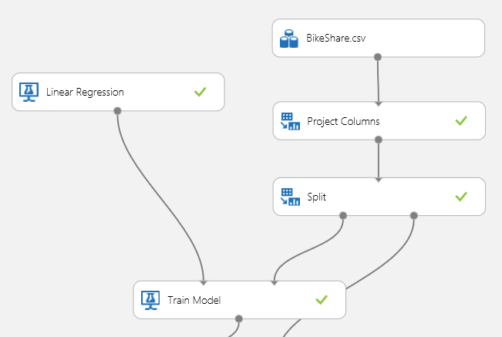
Bike share demand prediction
How many bikes will be used in a particular hour?
Model in Azure ML
Data:
13 features including weather, day of the week, and temperature
17,000+ examples
Most data is numeric, i.e., temperature
Source:
UCI repository and capital bike share

Slide 12
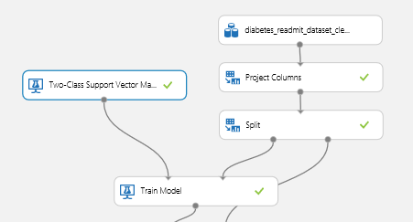
Hospital readmission
Which patients treated for diabetes related illness will be readmitted within 30 days?
Data:
35 features including age, gender, race, test results, treatment, etc.
100,000+ samples
Contains several categorical features
Source:
UCI repository and Virginia Commonwealth University
Model in Azure ML

Slide 13
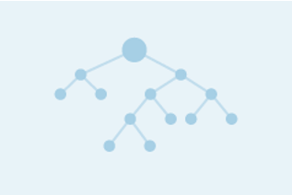
Decision Trees - Classification
What is does
Predicts class label Y based on input variables X
How it does it
Uses a series of decision rules in a binary tree where each leaf is a class label
Rules are determined by optimizing to reduce error

Slide 14
Decision Trees – Regression
What is does
Predicts scalar y based on input variables X
How it does it
Uses a series of decision rules in a binary tree where each leaf is a number
Rules are determined by optimizing to reduce error

Slide 15
Which algorithm should you pick?
Depends on your problem – what does your data look like?
Logistic regression, support vector machines are good for linear problems
Decision trees are intuitive and easy to interpret
Decision trees naturally handle categorical data, data scaling not required
Support vector machines are effective for high dimensional data
Basic decision trees are not as accurate…

Slide 16
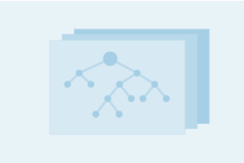
Advanced decision trees: Boosted Trees
What is does
Predicts class label (classification) or value (regression) Y based on variables X
How it does it
Uses a series of many trees to fit data. Each successive tree is built to reduce the estimated error the previous tree, resulting in increasingly accurate models
Caution
If number of trees is too large – can fit noise instead of good data, known as overfitting

Slide 17
Bike share demand prediction
How many bikes will be used in a particular hour?
Model in Azure ML
Data:
13 features including weather, day of the week, and temperature
17,000+ examples
Most data is numeric, i.e., temperature
Source:
UCI repository and capital bike share

Slide 18
Hospital readmission
Which patients treated for diabetes related illness will be readmitted within 30 days?
Data:
35 features including age, gender, race, test results, treatment, etc.
100,000+ samples
Contains several categorical features
Source:
UCI repository and Virginia Commonwealth University
Model in Azure ML

Slide 19
Advanced decision trees: Random Forest
What is does
Predicts class label (classification) or value (regression) Y based on variables X
How it does it
Builds many different trees using different random inputs (training data and features), aggregates those trees to determine final prediction
If trees are independent, having more trees does not result in overfitting

Slide 20
Advantages to each set of algorithms
Linear Algorithms (SVM, Logistic Regression)
easy to understand/interpret results
computationally efficient to train and score, even for large datasets
difficult to overfit data
Nonlinear (boosted decision tree, random forest)
can find irregular boundaries
natively handles categorical features
can achieve superior accuracy for many problems

Slide 21
Multiclass classification
Similar to binary classification, but with more than two labels
Some algorithms have multiclass classification versions (random forest), others have only binary classification (support vector machines, boosted decision tree)
Any binary classification algorithm becomes a multiclass algorithm with the use of the one-vs-all module

Slide 22
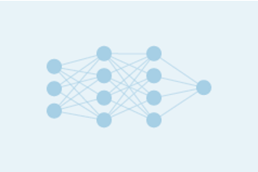
Neural Networks
What is does
Predicts class label (classification) or value (regression) Y based on variables X
How it does it
Is inspired by biological systems, i.e., neurons in the brain

Slide 23
Final thoughts on algorithm selection
Do what data scientists do---try multiple algorithms and select the best model for your data

Slide 24

© 2015 Microsoft Corporation. All rights reserved. Microsoft, Windows, and other product names are or may be registered trademarks and/or trademarks in the U.S. and/or other countries.
The information herein is for informational purposes only and represents the current view of Microsoft Corporation as of the date of this presentation. Because Microsoft must respond to changing market conditions, it should not be interpreted to be a commitment on the part of Microsoft, and Microsoft cannot guarantee the accuracy of any information provided after the date of this presentation. MICROSOFT MAKES NO WARRANTIES, EXPRESS, IMPLIED OR STATUTORY, AS TO THE INFORMATION IN THIS PRESENTATION.

